Slide 1
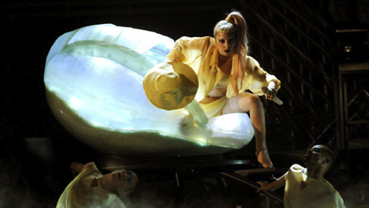

Slide 2
Possible Claim: Lady Gaga is an entertaining performer.

Slide 3
Evidence
    Elaborate costume
    Unique stage set
    She’s engaging the audience
    Extreme make up
    Multiple people on stage

Slide 4
Possible Claim: Lady Gaga is crazy.

Slide 5
Evidence
The look on her face
She is crawling out of an egg
Her make up makes her look inhuman

